Slide 1
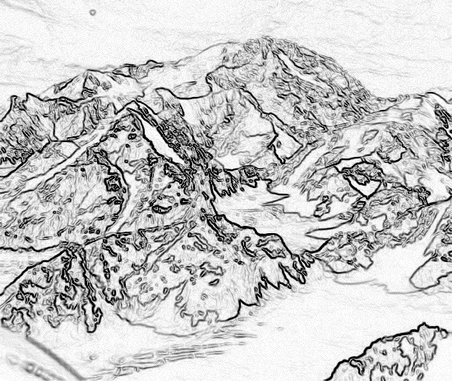
Chapter 2, Modeling with UML, Part 1

Slide 2
OMT, OOA&D, OOSE and UML
The first three methodologies, the modeling language is described by examples in which the concepts and relationships among them is presented by means of the concrete syntax.
The UML standard description is primarily focused on the abstract syntax, concrete syntax, semantics and at the end on some examples.
Apart of the above-mentioned methodologies UML is a modeling language including a complementary language, OCL to query the model, to specify different constraints and using the constraint language to define the abstract syntax of UML.

Slide 3
Using models in software development
For supporting problem and system understanding and communications between different participants (the approach described in Bruegge’s book and in almost all SE books).
For supporting all development phases including code generation in a significant manner also for supporting system understanding.
Model compilability and compliance with problem requirements
The current state of the art concerning RE tools
solutions

Slide 4
Overview for the Lecture
Three ways to deal with complexity
Abstraction and Modeling
Decomposition
Hierarchy
Introduction into the UML notation
First pass on:
Use case diagrams
Class diagrams
Sequence diagrams
Statechart diagrams
Activity diagrams

Slide 5
Abstraction
Complex systems are hard to understand
The 7 +- 2 phenomena
Our short-term memory cannot store more than 7+-2 pieces at the same time -> limitation of the brain
TUM Phone Number: 498928918204
Notes:
Inherent human limitation to deal with complexity
In philosophical terminology, abstraction is
Definition (Wikipedia): An abstraction is an idea, concept, or word which defines the phenomena
which make up the concrete events or things which the abstraction refers to
A model is a construct that represents physical, biological or social systems, with a set of variables and a set of logical and quantitative relationships between them.
Models are constructed to enable reasoning within a idealized logical framework about these systems and are an important component of scientific theories.
Idealized here means that the model may make explicit assumptions that are known to be false in some detail, but by their simplification of the model allow the production of acceptably accurate solutions.
(Animation) This is a scale model of a real train.
A scale model is a replica or prototype of an object built either for research or as a hobby,
usually built smaller than the existing or intended thing, though can equally be built larger to illustrate
something that would otherwise be hard to see.

Slide 6
Abstraction
Complex systems are hard to understand
The 7 +- 2 phenomena
Our short-term memory cannot store more than 7+-2 pieces at the same time -> limitation of the brain
TUM Phone Number: 498928918204
Chunking:
Group collection of objects to reduce complexity
4 chunks:
State-code, city-code, TUM-code, Office-Part
Notes:
Inherent human limitation to deal with complexity
In philosophical terminology, abstraction the process in concept-formation of recognizing some set of common features in individuals.
Definition (Wikipedia): An abstraction is an idea, concept, or word which defines the phenomena which make up the concrete events or things which the abstraction refers to
A model is a construct that represents physical, biological or social systems, with a set of variables and a set of logical and quantitative relationships between them.
Models are constructed to enable reasoning within a idealized logical framework about these systems and are an important component of scientific theories.
Idealized here means that the model may make explicit assumptions that are known to be false in some detail, but by their simplification of the model allow the production of acceptably accurate solutions.

Slide 7
Abstraction
Complex systems are hard to understand
The 7 +- 2 phenomena
Our short-term memory cannot store more than 7+-2 pieces at the same time -> limitation of the brain
TUM Phone Number: 498928918204
Chunking:
Group collection of objects to reduce complexity
State-code, city-code, TUM-code, Office-Part
TUM Phone Number
State-Code
City-Code
TUM-code
Office-Part

Slide 8
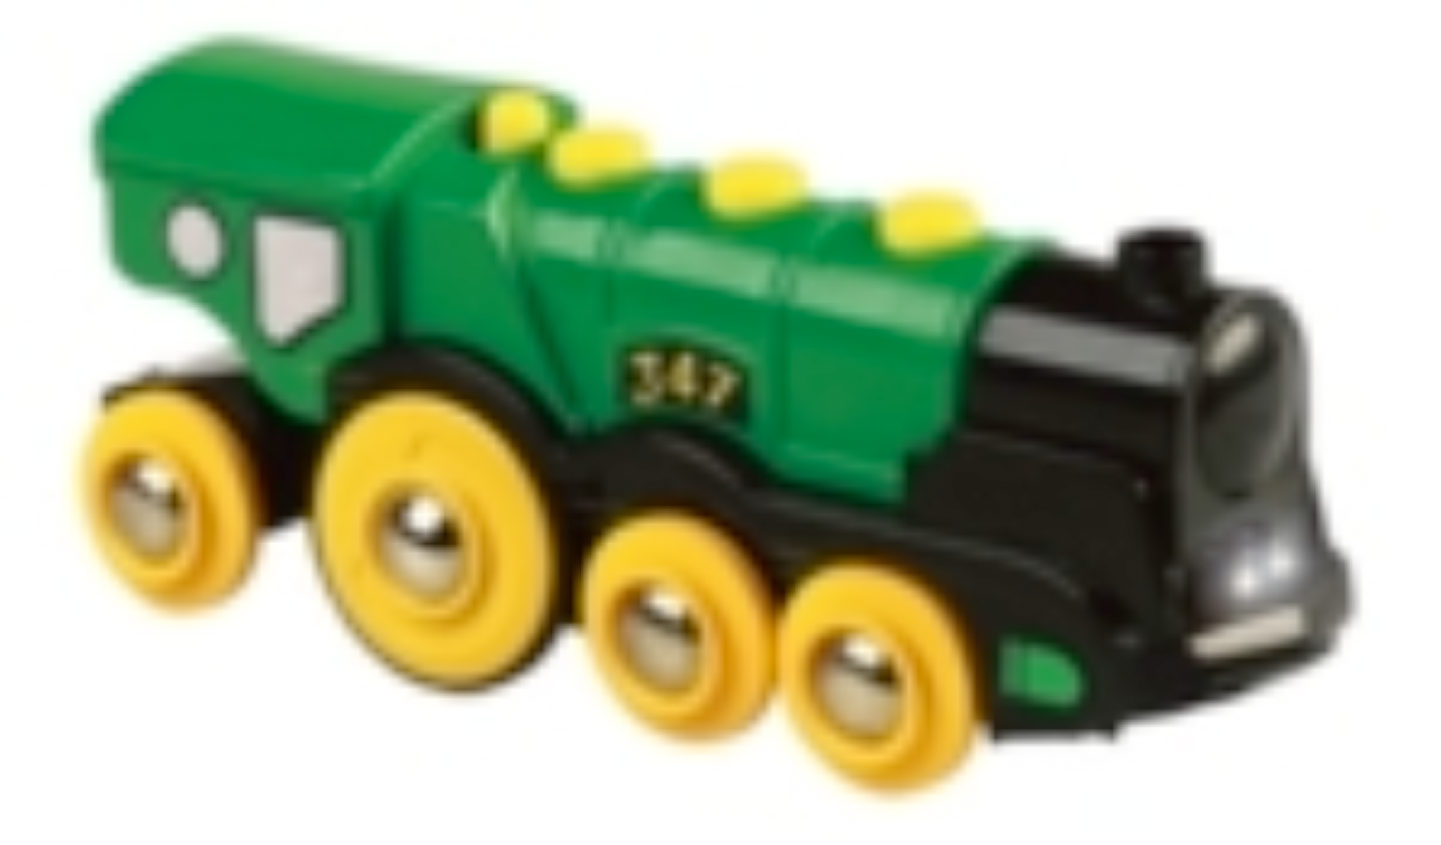
Abstraction
Abstraction allows us to ignore unessential details
Two definitions for abstraction:
Abstraction as activity
Abstraction is the resulting idea of a thought process where an in which the idea has been distanced from an the object
Abstraction as entity
Ideas can be expressed by models
Models are expressed by means of ideas
Notes:
(Animation) This is a scale model of a real train.
A scale model is a replica or prototype of an object built either for research or as a hobby,
usually built smaller than the existing or intended thing, though can equally be built larger to illustrate
something that would otherwise be hard to see.

Slide 9
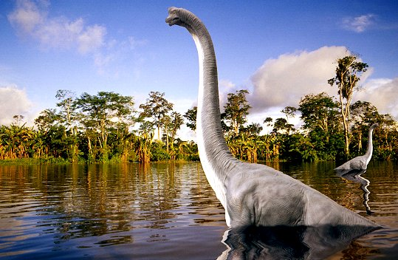
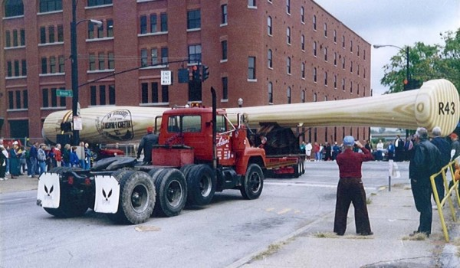
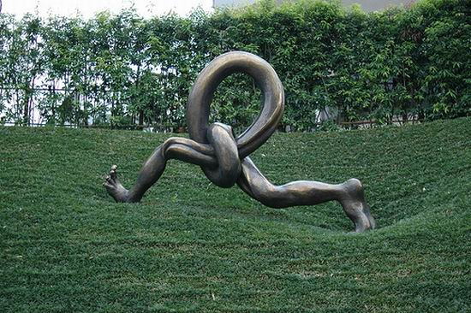
Model
A model is an abstraction of a system
A system that no longer exists
An existing system
A future system to be built.
Notes:
Many methods that have been successfully applied in the natural sciences and humanities can be applied to the sciences of the artificial as well.
By looking at the other sciences, we can learn quite a bit. One of the basic methods of science is modeling.
A model is an abstract representation of a system that enables us to answer questions about the system.
Models are useful when dealing with systems that are too large, too small, too complicated, or too expensive to experience firsthand.
Models also allow us to visualize and understand systems that either no longer exist or that are only claimed to exist.
Fossil biologists unearth a few bones and teeth preserved from some dinosaur that no one has ever seen. From the bone fragments, they reconstruct a model of the animal, following rules of anatomy. The more bones they find, the clearer their idea of how the pieces fit together and the higher the confidence that their model matches the original dinosaur. If they find a sufficient number of bones, teeth, and claws, they can almost be sure that their model reflects reality accurately, and they can guess the missing parts. Legs, for example, usually come in pairs. If the left leg is found, but the right leg is missing, the fossil biologists have a fairly good idea what the missing leg should look like and where it fits in the model. This is an example of a model of a system that no longer exists
Today’s high-energy physicists are in a similar position to that of a fossil biologist who has found most of the bones. Physicists are building a model of matter and energy and how they fit together at the most basic subatomic level. Many years of experiments with particle accelerators have given high-energy physicists enough confidence that their models reflect reality and that the remaining pieces that are not yet found will fit into the so-called standard model. This is an example of a model for a system that is claimed to exist.

Slide 10
We use Models to describe Software Systems
Object/Structural model/view: What is the structure of the system?
Functional model/view: What are the functions of the system?
Dynamic/Behavioral model/view: How does the system react to external events?
System/Application Model: Object /Structural model + Functional model + Dynamic model
Notes:
Object model: What is the structure of the system? What are the objects and how are they related?
Functional model: What are the functions of the system? How is data flowing through the system?
Dynamic model: How does the system react to external events? How is the event flow in the system ?

Slide 11
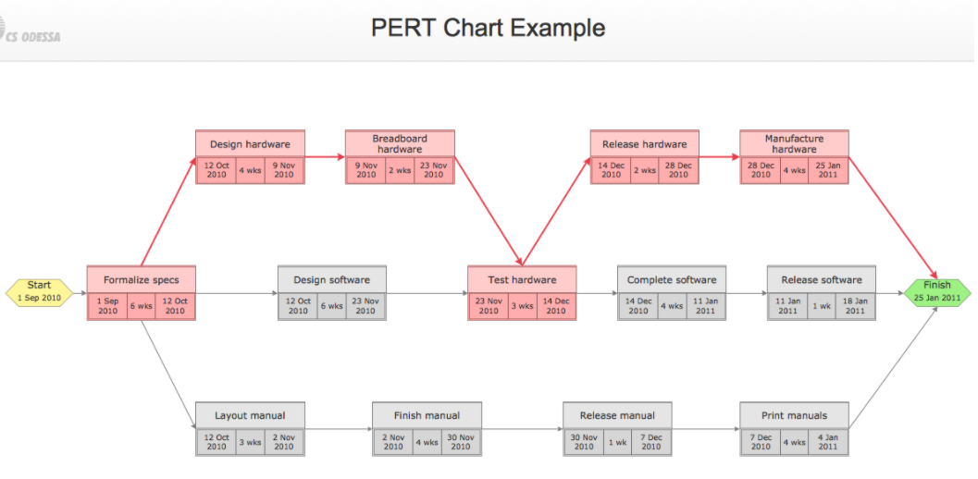
Other models used to describe Software System Development
Task Model:
PERT Chart: What are the dependencies between tasks?
Notes:
Object model: What is the structure of the system? What are the objects and how are they related?
Functional model: What are the functions of the system? How is data flowing through the system?
Dynamic model: How does the system react to external events? How is the event flow in the system ?

Slide 12
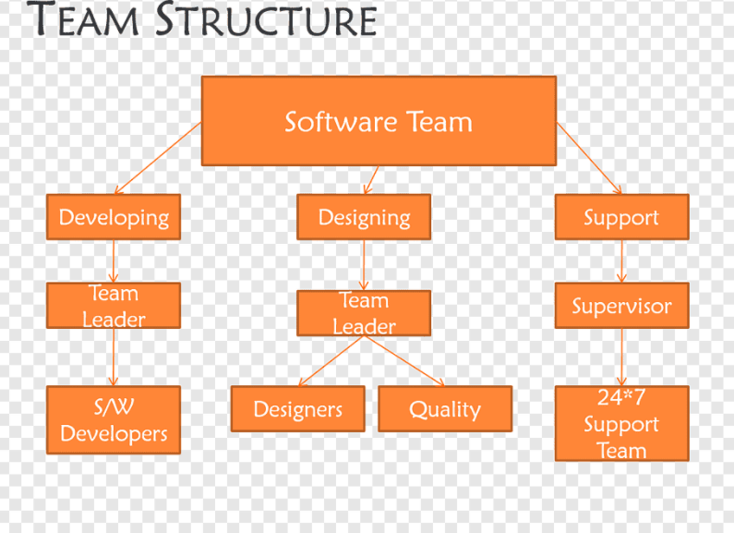
Also, models may be used to describe Software System Development
Task Model:
Organization Chart: What are the roles in the project?
Issues Model:
What are the open and closed issues?
What blocks me from continuing?
What constraints were imposed by the client?
What resolutions were made?
These lead to action items
Notes:
Object model: What is the structure of the system? What are the objects and how are they related?
Functional model: What are the functions of the system? How is data flowing through the system?
Dynamic model: How does the system react to external events? How is the event flow in the system ?

Slide 13
Issue-Modeling - Knowledge acquisition is a nonlinear process
Issue:
What is the
Center of the
Universe?
Proposal1:
The earth!
Proposal2:
The sun!
Pro:
Aristotle
says so.
Pro:
Copernicus
says so.
Con:
Jupiter’s moons rotate
around Jupiter, not
around Earth.
Pro:
Change will disturb
the people.

Slide 14
Issue-Modeling - Knowledge acquisition is a nonlinear process
Issue:
What is the
Center of the
Universe?
Resolution (1615):
The church
decides proposal 1
is right
Proposal1:
The earth!
Proposal2:
The sun!
Pro:
Aristotle
says so.
Pro:
Copernicus
says so.
Con:
Jupiter’s moons rotate
around Jupiter, not
around Earth.
Pro:
Change will disturb
the people.

Slide 15
Issue-Modeling - Knowledge acquisition is a nonlinear process
Issue:
What is the
Center of the
Universe?
Resolution (1998):
The church declares
proposal 1 was wrong
Resolution (1615):
The church
decides proposal 1
is right
Proposal1:
The earth!
Proposal3:
Neither!
Proposal2:
The sun!
Pro:
Aristotle
says so.
Pro:
Copernicus
says so.
Con:
Jupiter’s moons rotate
around Jupiter, not
around Earth.
Pro:
Change will disturb
the people.
Pro:
Galaxies are moving away
From each other.

Slide 16
Models must be falsifiable - Knowledge acquisition is a nonlinear process
Karl Popper (“Objective Knowledge):
There is no absolute truth when trying to understand reality
One can only build theories, that are “true” until somebody finds a counter example
Falsification: The act of disproving a theory or hypothesis
The truth of a theory is never certain. We must use phrases like:
“by our best judgement”, “using state-of-the-art knowledge”
In software engineering any model is a theory:
We build models and try to find counter examples by:
Requirement's validation, user interface testing, review of the design, source code testing, system testing, etc.
Testing: The act of disproving a model.

Slide 17
2. Technique to deal with Complexity: Decomposition
A technique used to master complexity (“divide and conquer”)
Two major types of decomposition
Functional decomposition
Object-oriented decomposition
Functional decomposition
The system is decomposed into modules/subsystems
Each module/ subsystem provides a major function in the application domain
Modules can be decomposed into smaller modules.
Notes:
Which decomposition is the right one? If you think you are politically correct, you probably want to answer: Object-oriented. But that is actually wrong. Both views are important
Functional decomposition emphasizes the ordering of operations, very useful at requirements engineering stage and high-level description of the system.
Object-oriented decomposition emphasizes the agents that cause the operations. Very useful after initial functional description. Helps to deal with change (usually object don’t change often, but the functions attached to them do).

Slide 18
Decomposition (cont’d)
Object-oriented decomposition
The system is decomposed into classes (“objects”)
Each class is a major entity in the application domain
Classes can be decomposed into smaller classes
Object-oriented vs. functional decomposition
Which decomposition is the right one?
Notes:
Which decomposition is the right one? If you think you are politically correct, you probably want to answer: Object-oriented. But that is actually wrong. Both views are important
Functional decomposition emphasises the ordering of operations, very useful at requirements engineering stage and high-level description of the system.
Object-oriented decomposition emphasizes the agents that cause the operations. Very useful after initial functional description. Helps to deal with change (usually object don’t change often, but the functions attached to them do).

Slide 19
Functional Decomposition
System
Function
Top Level functions
Read Input
Transform
Produce
Output
Level 1 functions
Read Input
Transform
Produce
Output
Level 2 functions
Load R10
Add R1, R10
Machine instructions

Slide 20
Functional Decomposition
The functionality is spread all over the system
Maintainer must understand the whole system to make a single change to the system
Consequence:
Source code is hard to understand
Source code is complex and impossible to maintain
User interface is often awkward and non-intuitive
Example: Microsoft Powerpoint’s Autoshapes
How do I change a square into a circle?
?

Slide 21
Changing a Square into a Circle

Slide 22
Functional Decomposition: Autoshape
Autoshape
Change
Draw
Change
Rectangle
Change
Oval
Change
Circle
Draw
Rectangle
Draw
Oval
Draw
Circle

Slide 23
Object-Oriented View
Autoshape
Draw()
Change()

Slide 24

What is This?
An Eskimo!
Cave
Ellbow
Neck
Glove
Pocket
Coat

Slide 25
A Face!
Hair
Eye
Nose
Ear
Mouth
Chin

Slide 26
An Eskimo!
A Face!
Cave
Hair
Neck
Eye
Ellbow
Nose
Ear
Glove
Pocket
Mouth
Coat
Chin

Slide 27
Class Identification
Basic assumptions:
We can find the classes for a new software system: Greenfield Engineering
We can identify the classes in an existing system: Reengineering
We can create a class-based interface to an existing system: Interface Engineering
Notes:
This basic assumption is crucial for object-oriented modeling.
We can identify objects first and attach functions to them.
We can find the classes for a new software system We call this Greenfield Engineering
We can identify the classes in an existing system We call this Reengineering
We can create a class-based interface to an existing system: We call this Interface Engineering
Depending on the purpose of the system different objects might be found: A nose is suddenly an elbow, hair is a cave, an ear turns out to be a glove.

Slide 28
Class Identification (cont’d)
Why can we do this?
Philosophy, science, experimental evidence
What are the limitations?
Depending on the purpose of the system, different objects might be found
Crucial
Identify the purpose of a system
Notes:
This basic assumptio is crucial for object-oriented modeling.
We can identify objects first, and attach functions to them.
We can find the classes for a new software system We call this Greenfield Engineering
We can identify the classes in an existing system We call this Reengineering
We can create a class-based interface to an existing system: We call this Interface Engineering
Depending on the purpose of the system different objects might be found: A nose is suddenly an elbow, hair is a cave, an ear turns out to be a glove.

Slide 29
3. Hierarchy
So far, we got abstractions
This leads us to classes and objects
“Chunks”
Another way to deal with complexity is to provide relationships between these chunks
One of the most important relationships is hierarchy
2 special hierarchies
"Part-of" hierarchy
"Is-kind-of" hierarchy
Notes:
A hierarchy (in greek: hieros, sacred, and arkho, rule) is a system of organizing things.
Hierarchies can be generally divided into two kinds:
those where the upper levels of the hierarchy are 'superior' to the lower in some way, and those where the lower levels are 'contained' in the upper, again in different ways.
An example of the first kind might be a company organisational structure: the CEO is superior to the divisional managers, who are superior to their team leaders who are superior to their ordinary workers.
An example of the second kind is the hierarchy of animal classification: the set of 'birds' contains the set of 'birds of prey’ which contains the set of 'eagles' which contains the set of 'golden eagles'

Slide 30
Part-of Hierarchy (Aggregation)
Computer
I/O Devices
CPU
Memory
Cache
ALU
Program
Counter

Slide 31
Is-Kind-of Hierarchy (Taxonomy)
Cell
Muscle Cell
Blood Cell
Nerve Cell
Striate
Smooth
Red
White
Cortical
Pyramidal

Slide 32
Where are we now?
Three ways to deal with complexity:
Abstraction, Decomposition, Hierarchy
Object-oriented decomposition is good
Unfortunately, depending on the purpose of the system, different objects can be found (an eskimo or a far-west Indian)
How can we do it right?
Start with a description of the functionality of a system
Then proceed to a description of its structure
Ordering of development activities
Software lifecycle
Notes:
The identification of objects and the definition of the system boundary are heavily intertwined with each other.
That is, we are ordering the development activities in a certain way

Slide 33
Concepts and Phenomena
Phenomenon
An object in the world of a domain as you perceive it
Examples: This lecture at 9:35, my black watch
Concept
The description of the common properties of phenomenon
Example: All lectures on software engineering
Example: All black watches
A Concept is a 3-tuple:
Name: The name distinguishes the concept from other concepts
Purpose: Properties that determine if a phenomenon is a member of a concept
Members: The set of phenomena which are part of the concept.

Slide 34
Concepts, Phenomena, Abstraction and Modeling
Name
Purpose
Members
Watch
A device that
measures time.
Definition Abstraction:
Classification of phenomena into concepts
Definition Modeling:
Development of abstractions to answer specific questions about a set of phenomena while ignoring irrelevant details.
Notes:
Hourglass

Slide 35
Abstract Data Types & Classes
Superclass/Parent
State/Class Attributes
Abstract data type
A type whose implementation is hidden from the rest of the system
Class:
An abstraction in the context of object-oriented languages
A class encapsulates state structure and behavior specification
Example: Watch
Watch
time
date
SetDate(d)
Behavior
Inheritance
CalculatorWatch
calculatorState
Unlike abstract data types, subclasses can be defined in terms of other classes using inheritance
EnterCalcMode()
InputNumber(n)
Example: CalculatorWatch
Subclass/Child

Slide 36
Type and Instance
Type:
A concept in the context of programming languages
Name: int
Purpose: integral number
Members: 0, -1, 1, 2, -2,…
Instance:
Member of a specific type
The type of a variable represents all possible instances of the variable
The following relationships are similar/related:
Type <–> Variable
Concept <–> Phenomenon
Class <-> Object

Slide 37
Systems
A system is an organized set of communicating parts
Natural system: A system whose ultimate purpose is not known
Engineered system: A system which is designed and built by engineers for a specific purpose
The parts of the system can be considered as systems again
In this case we call them subsystems
Examples of natural systems: • Universe, earth, ocean
Examples of engineered systems: • Airplane, watch, GPS
Examples of subsystems:
• Jet engine, battery, satellite.

Slide 38

Systems, Models and Views
• A model is an abstraction describing a system or a subsystem
• A view depicts selected aspects of a model
A notation is a set of graphical or textual rules for depicting models and views:
formal notations, “napkin designs”
System: Airplane
Models:
Flight simulator
Scale model
Views:
Blueprint of the airplane components
Electrical wiring diagram, Fuel system
Sound wave created by airplane
Notes:
A view is a subset of a model that makes it more understandable
Alle the blueprints needed to build a scale model are a view of the scale model.
The film shows a flyby of a F-14 airplane at an aircraft carrier reaching supersonic speed. The sound wave can be well seen.

Slide 39
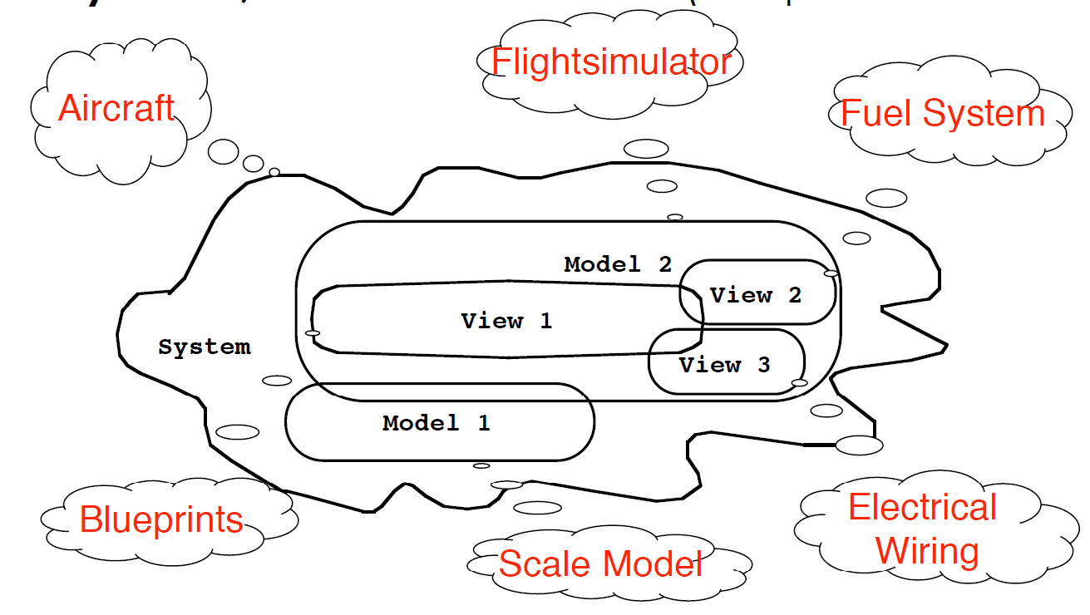
Systems, Models and Views
(“Napkin” Notation)
Views and models of a complex system usually overlap
Notes:
This is a graphical notation of a system.
We show the systems and subsystems as areas and annotate them with clouds containing the name of the system.
It is important to notice that we use this type of notation in many situations, we might write it down in the sand on the beach, we might use a napkin in a restaurant.
It is a conceptual description of the system, using a free format notation.
For this reason, I call it the napkin notation

Slide 40
Systems, Models and Views
(UML Notation)
Class Diagram
*
*
System
Model
View
Described by
Depicted by
Airplane: System
Object Diagram
Scale Model:Model
Flight Simulator:Model
Blueprints: View
Fuel System: View
Electrical Wiring: View
Notes:
UML is designed to restrict the set of notations that we can use to describe a system.
The advantage is, that we can generate tools that translate these notation into source code of a higher programming language.
These tools are called CASE tools.
A view is a subset of a model that makes it more understandable
Alle the blueprints needed to build a scale model are a view of the scale model.

Slide 41
Model-Driven Development
Build a platform-independent model of an applications functionality and behavior
a) Describe model in modeling notation (UML)
b) Convert model into platform-specific model
Generate executable from platform-specific model
Advantages:
Code is generated from model (“mostly”)
Portability and interoperability
Model Driven Architecture effort:
http://www.omg.org/mda/
OMG: Object Management Group
Notes:
- MDD is the current holy grail of software development
Software development in the MDA starts with a Platform-Independent Model (PIM) of an application's business functionality and behavior, constructed using a modeling language based on OMG's MetaObject Facility (MOF).
- This model remains stable as technology evolves, extending and thereby maximizing software ROI. MDA development tools, available now from many vendors, convert the PIM first to a Platform-Specific Model (PSM) and then to a working implementation on virtually any middleware platform: Web Services, XML/SOAP, EJB, C#/.Net, OMG's own CORBA, or others.
- Portability and interoperability are built into the architecture.
- OMG Task Forces organized around industries including Finance, Manufacturing, Biotechnology, Space technology, and others use the MDA to standardize facilities in their domains.

Slide 42
Model-driven Software Development
Reality: A stock exchange lists many companies. Each company is identified by a ticker symbol
Analysis results in analysis object model (UML Class Diagram):
*
*
Company
StockExchange
Lists
tickerSymbol
Implementation results in source code (Java):
public class StockExchange {
public m_Company = new Vector();
};
public class Company {
public int m_tickerSymbol;
public Vector m_StockExchange = new Vector();
};
Notes:
One way to develop is to start with a problem statement from the customer and turn it into a system model.
Here we have converted a textual description of a stock exchange into a UML class diagram.
Does this model reflect the problem statement? The association between the stock exchange and company is many to many, as we call it. It means that each stock exchange has many companies, and that there are companies that are listed on more than one stock exchange. Is this correct?
To see if this model reflects reality, we have to find a stock exchange, that lists more than one company, that is easy. The NASDAQ stock exchange lists Adobe and SUN, so we found one example in reality.
For the other direction it initially looks tougher, is there a company listed on more than one stock exchange? Think about it?
One example is DaimlerChrysler, which is listed on the NYSE and on the Frankfurter Boerse.

Slide 43
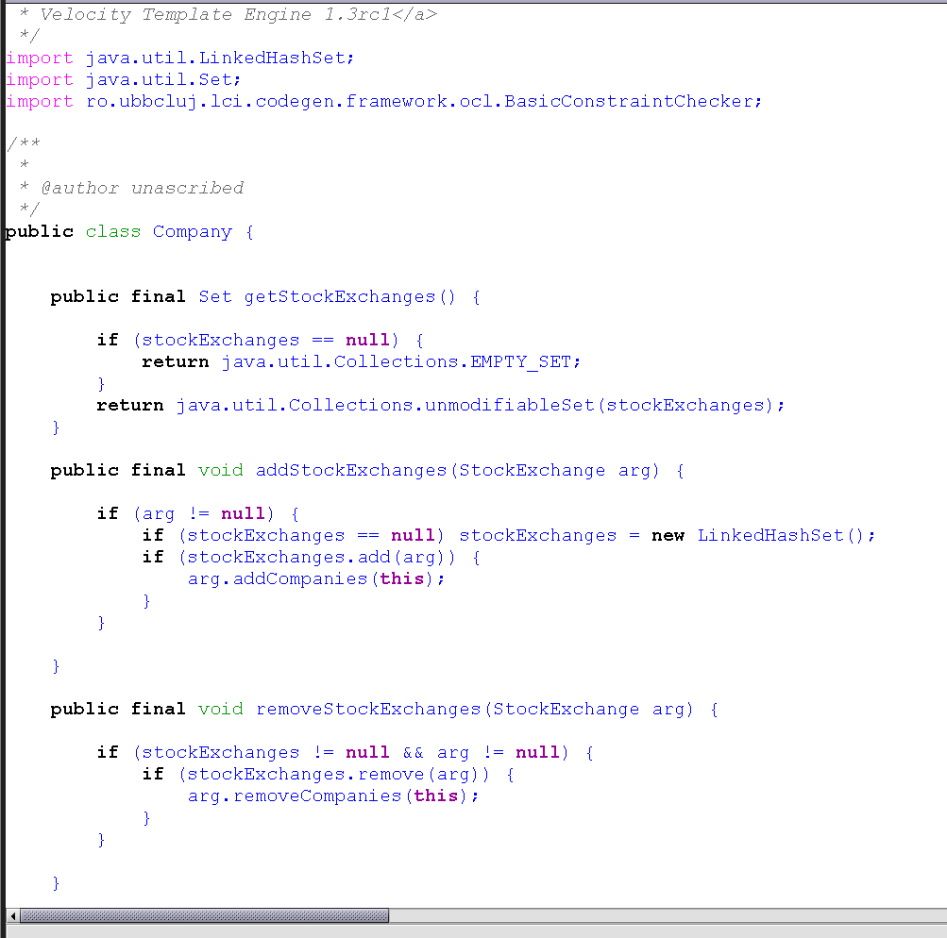
OCLE Code Sample for StockExchange model
Notes:
Recall system model:
Functional model, object model and dynamic model

Slide 44
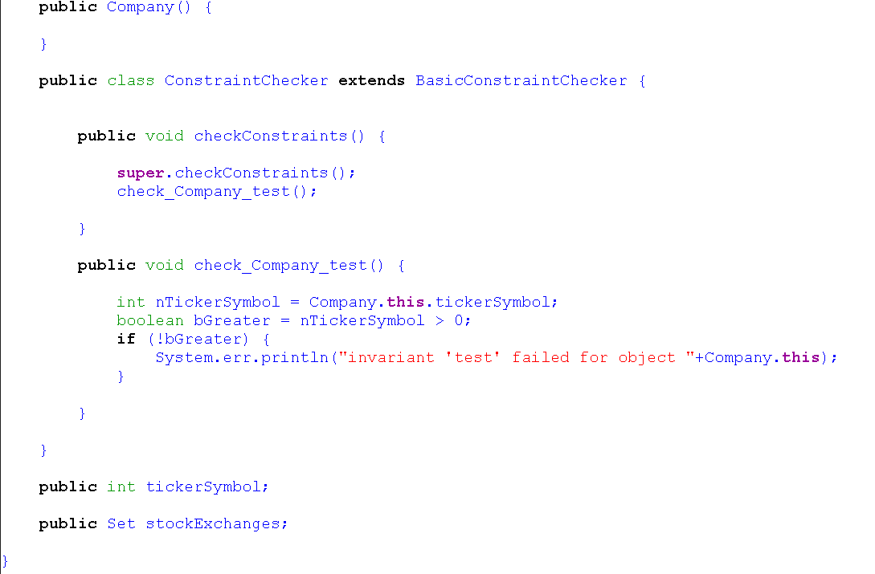
OCLE Code Sample for StockExchange model
Notes:
Recall system model:
Functional model, object model and dynamic model

Slide 45
Application vs Solution Domain
Application Domain (Analysis):
The environment in which the system is operating
Solution Domain (Design, Implementation):
The technologies used to build the system
Both domains contain abstractions that we can use for the construction of the system model.
Notes:
Recall system model:
Functional model, object model and dynamic model

Slide 46
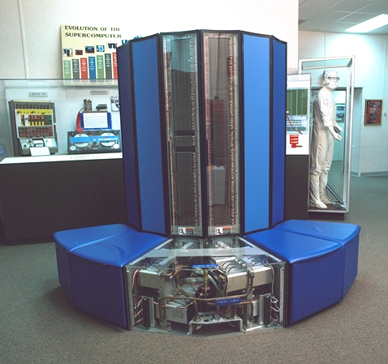

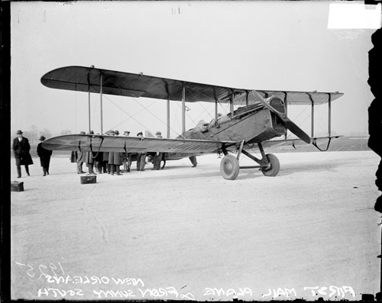
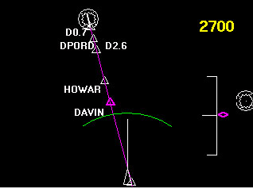


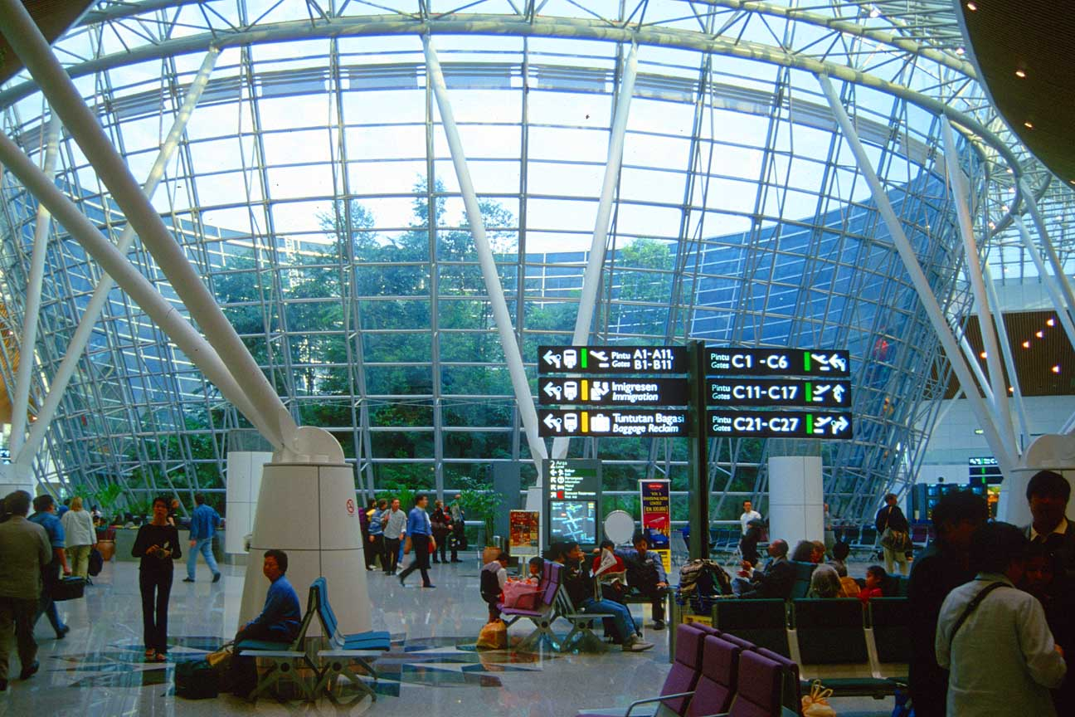

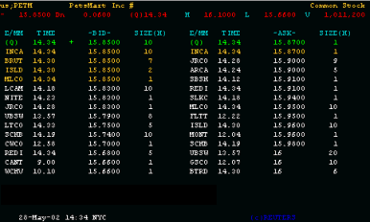
Object-oriented Modeling
Application Domain (Phenomena)
Solution Domain (Phenomena)
System Model (Concepts)
(Analysis)
System Model (Concepts)
(Design)
UML
Package
Summary
Display
MapDisplay
TrafficControl
TrafficController
FlightPlanDatabase
Aircraft
TrafficControl
Airport
FlightPlan

Slide 47
What is UML?
UML (Unified Modeling Language)
Nonproprietary standard for modeling software systems, OMG
Convergence of notations used in object-oriented methods
OMT (James Rumbaugh and colleagues)
Booch (Grady Booch)
OOSE (Ivar Jacobson)
Current Version: UML 2.5.1 -https://www.omg.org/spec/UML/2.5.1
Information at the OMG portal http://www.uml.org/

Slide 48
UML tools
IBM Rational Software Architect Designer - This trial is fully functional. Download the trial for an evaluation period of 60 days. (See notes for extensions and limitations.) https://www.ibm.com/developerworks/downloads/r/architect/index.html?mhsrc=ibmsearch_a&mhq=ibm%20rational%20architect
ENTERPRISE ARCHITECT - Trial Free For 30 Days! https://sparxsystems.com/products/ea/
MagicDraw - https://www.nomagic.com/products/magicdraw offer trial version
Visual Paradigm - https://www.visual-paradigm.com/ - No registration. 30-day FREE Trial
UMPLE - https://cruise.umple.org/umple/

Slide 49
UML: First Pass
You can model 80% of most problems by using about 20 % UML
We teach you those 20% - for using UML to support communication and understanding
80-20 rule: Pareto principle
http://www.ephorie.de/hindle_pareto-prinzip.htm

Slide 50
UML First Pass
Use case diagrams
Describe the functional behavior of the system as seen by the user
Class diagrams
Describe the static structure of the system: Objects, attributes, associations
Sequence diagrams
Describe the dynamic behavior between objects of the system
Statechart diagrams
Describe the dynamic behavior of an individual object
Activity diagrams
Describe the dynamic behavior of a system, in particular the workflow.
Notes:
Statechart diagrams
Describe the dynamic behavior of an individual object (essentially a finite state automaton)
Activity Diagrams
Model the dynamic behavior of a system, in particular the workflow (essentially a flowchart)

Slide 51
UML Core Conventions
All UML Diagrams denote graphs of nodes and edges
Nodes are entities and drawn as rectangles or ovals
Rectangles denote classes or instances
Ovals denote functions
Names of Classes are not underlined
SimpleWatch
Firefighter
Names of Instances are underlined
myWatch:SimpleWatch
Joe:Firefighter
An edge between two nodes denotes a relationship between the corresponding entities

Slide 52
UML first pass: Use case diagrams
Classifier
Use Case
Actor.
System boundary
Use case diagrams represent the functionality of the system
from user’s point of view

Slide 53
Historical Remark: UML 1 used packages
Package
Use case
Watch
Actor
ReadTime
WatchUser
SetTime
WatchRepairPerson
ChangeBattery
Use case diagrams represent the functionality of the system
from user’s point of view

Slide 54
UML first pass: Class diagrams
Association
Class
Multiplicity
SimpleWatch
1
1
1
1
2
1
2
1
PushButton
Display
Battery
Time
Class diagrams represent the structure of the system

Slide 55
UML first pass: Class diagrams
Class diagrams represent the structure of the system
Association
Class
Multiplicity
Watch
1
1
1
1
2
1
2
1
PushButton
state
LCDDisplay
Battery
Load
Time
Now
push() release()
blinkIdx
blinkSeconds()
blinkMinutes()
blinkHours()
stopBlinking()
referesh()
Operations
Attribute

Slide 56
UML first pass: Sequence diagram
Actor
Message
Object
Lifeline
:WatchUser
:Watch
:LCDDisplay
:Time
pressButton1()
blinkHours()
pressButton1()
blinkMinutes()
pressButton2()
incrementMinutes()
refresh()
pressButton1and2()
commitNewTime()
stopBlinking()
Activation
Sequence diagrams represent the behavior of a system
as messages (“interactions”) between different objects

Slide 57
UML first pass: Statechart diagrams
Event
Initial state
button1&2Pressed
button2Pressed
Blink
Increment
Hours
Hours
Transition
button1Pressed
button1&2Pressed
Blink
button2Pressed
Increment
State
Minutes
Minutes
button1Pressed
button2Pressed
Stop
Blink
Increment
Blinking
Seconds
Seconds
Final state
Represent behavior of a single object with interesting dynamic behavior.
Notes:
Represent behavior of single objects with interesting dynamic behavior in terms of states and transitions
The behavior of the single object Watch, for example, has several different interesting states, BlinkHours, BlinkMinutes, BlinkSeconds,
Because in each state pressing a button or two yields a different result.

Slide 58
Other UML Notations
UML provides many other notations, for example
Deployment diagrams for modeling configurations
Useful for testing and for release management
We introduce these and other notations as we go along in the lectures
OCL: A language for constraining UML models
Notes:
In particular, in the lecture on System Design we introduced Deployment Diagrams, in the lecture on Testing we introduce Profiles.
There is also a language to constrain the systems that can be instantiated from models. The language that has been designed to constain UML models is called OCL (Object constraint language) Introduced in lecture on Object Design

Slide 59
What should be done first? Coding or Modeling?
It all depends….
Forward Engineering
Creation of code from a model
Start with modeling
Greenfield projects
Reverse Engineering
Creation of a model from existing code
Interface or reengineering projects
Roundtrip Engineering
Move constantly between forward and reverse engineering
Reengineering projects
Useful when requirements, technology and schedule are changing frequently.

Slide 60
UML Basic Notation Summary
UML provides a wide variety of notations for modeling many aspects of software systems
Today we concentrated on a few notations:
Functional model: Use case diagram
Object model: Class diagram
Dynamic model: Sequence diagrams, statechart
Notes:
Powerful, but complex language
Warning: Can also be misused to generate unreadable models
Warning: Can be misunderstood when using too many exotic features

Slide 61
Additional References
Martin Fowler
UML Distilled: A Brief Guide to the Standard Object Modeling Language, 3rd ed., Addison-Wesley, 2003
Grady Booch,James Rumbaugh,Ivar Jacobson
The Unified Modeling Language User Guide, Addison Wesley, 2nd edition, 2005
The Unified Modeling Language Reference Manual, 2nd Edition, Addison Wesley, 2004
The Unified Software Development Process, Addison-Wesley 1st Edition, 1999
Martina Seidl, Marion Scholz, Christian Huemer, Gerti Kappel
UML @ Classroom - An Introduction to Object-Oriented Modeling, Springer 2014
Notes:
Also:
- Together Designer 2006 for Eclipse
- Together Designer 2005, for Microsoftｨ Visual Studio.NET 2003
- Together Designer 2005, for JBuilderｨ 2005

